Slide 1
Condition Variables

Slide 2
Another type of sychronization
Locks allow one type of synchronization between threads – mutual exclusion
Another common requirement in multi-threaded applications – waiting and signaling
– E.g., Thread T1 wants to continue only after T2 has finished some task
Can accomplish this by busy-waiting on some variable, but inefficient
Need a new synchronization primitive: condition variables

Slide 3
Condition Variables
A condition variable (CV) is a queue that a thread can put itself into when waiting on some condition
Another thread that makes the condition true can signal the CV to wake up a waiting thread
Pthreads provides CV for user programs
– OS has a similar functionality of wait/signal for kernel threads
Signal wakes up one thread, signal broadcast wakes up all waiting threads

Slide 4
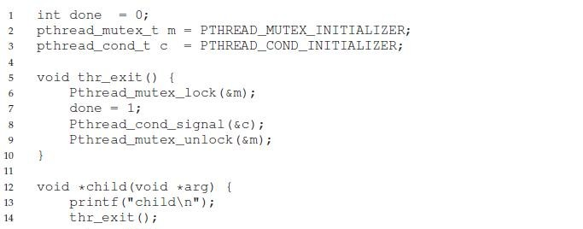
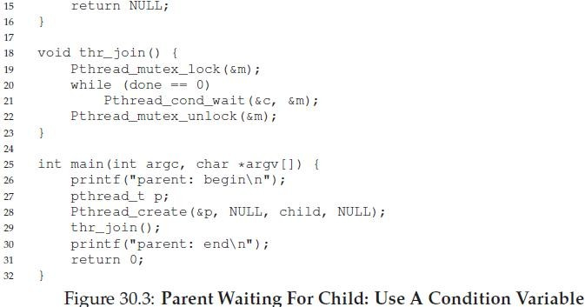
Example: parent waits for child

Slide 5
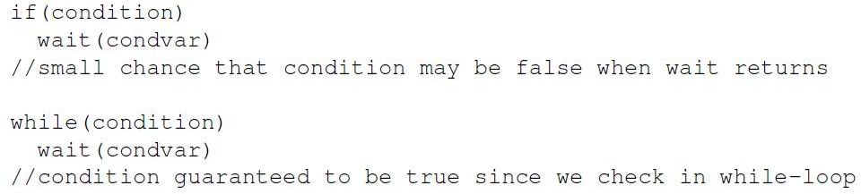
Why check condition in while loop?
In the example code, why do we check condition before calling wait?
  In case the child has already run and done is true, then no need to wait
Why check condition with “while” loop and not “if”?
  To avoid corner cases of thread being woken up even when condition not true (may be an issue with some implementations)
5

Slide 6
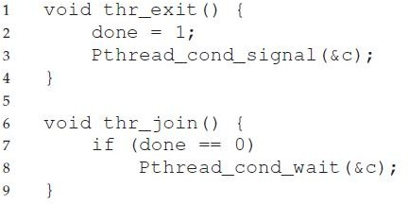
Why use lock when calling wait?
What if no lock is held when calling wait/signal?
Race condition: missed wakeup
  Parent checks done to be 0, decides to sleep, interrupted
  Child runs, sets done to 0, signals, but no one sleeping yet
  Parent now resumes and goes to sleep forever
Lock must be held when calling wait and signal with CV
The wait function releases the lock before putting thread to sleep, so lock is available for signaling thread

Slide 7
Example: Producer/Consumer problem
A common pattern in multi-threaded programs
Example: in a multi-threaded web server, one thread accepts requests from the network and puts them in a queue. Worker threads get requests from this queue and process them.
Setup: one or more producer threads, one or more consumer threads, a shared buffer of bounded size

Slide 8
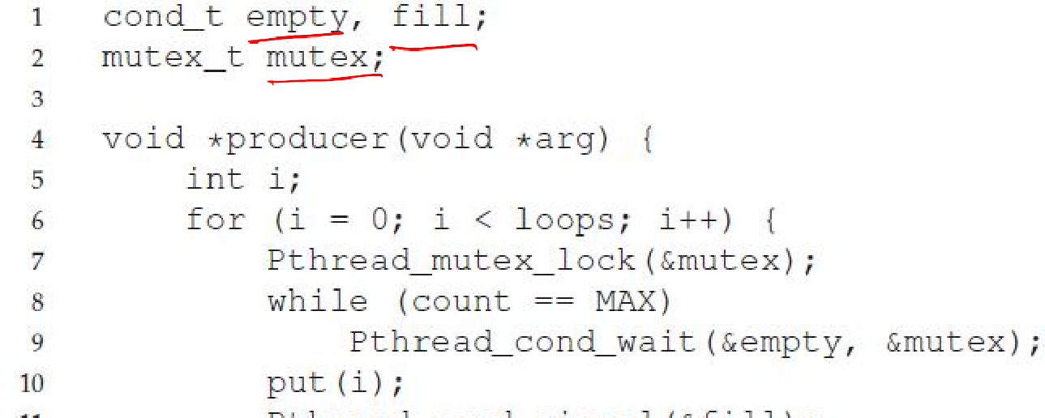
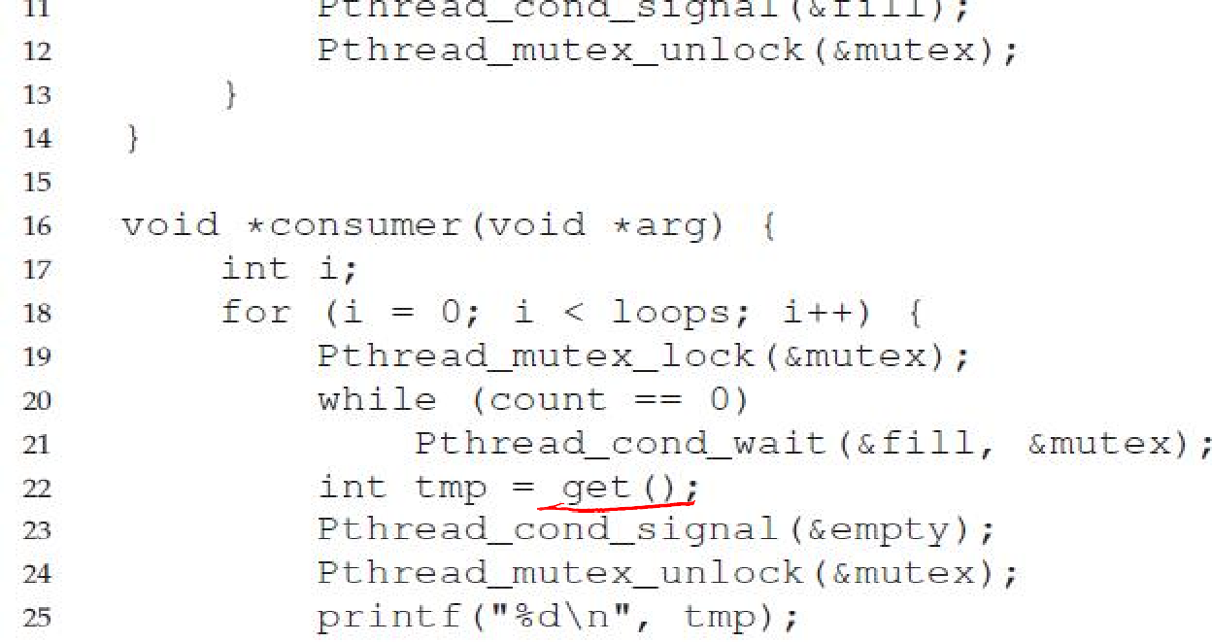
Producer/Consumer with 2 CVs

